Slide 1
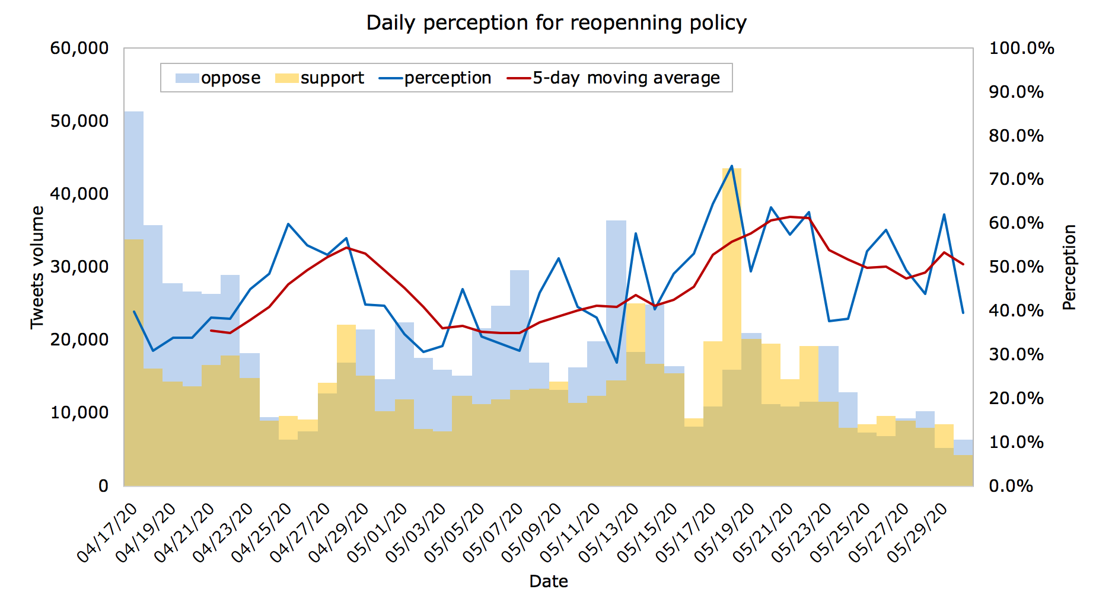
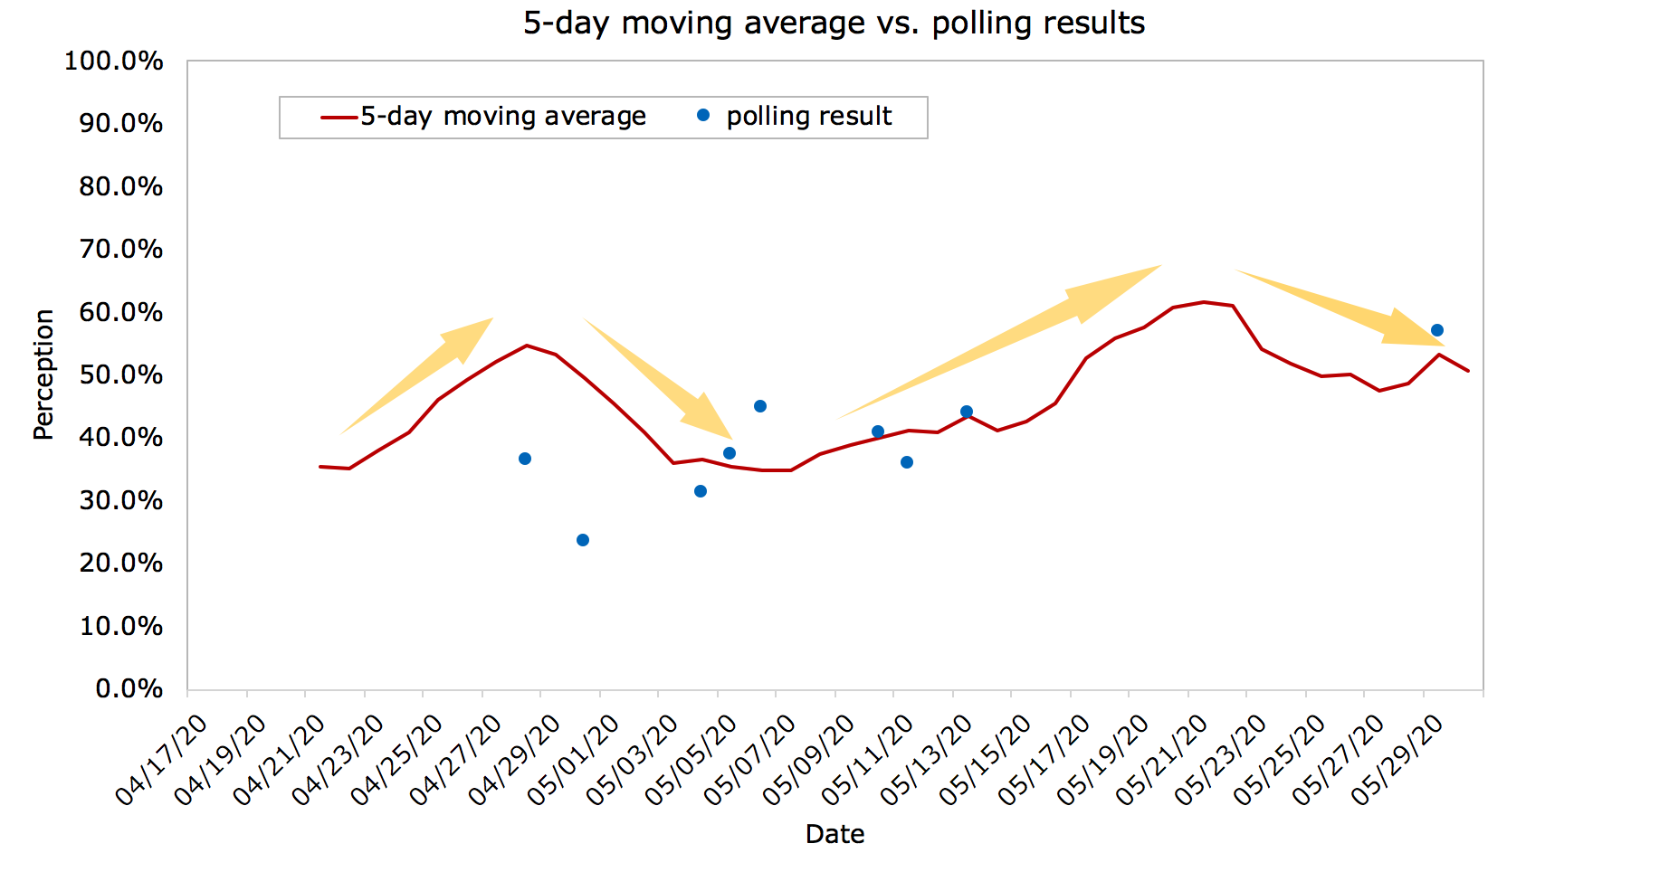

Slide 2
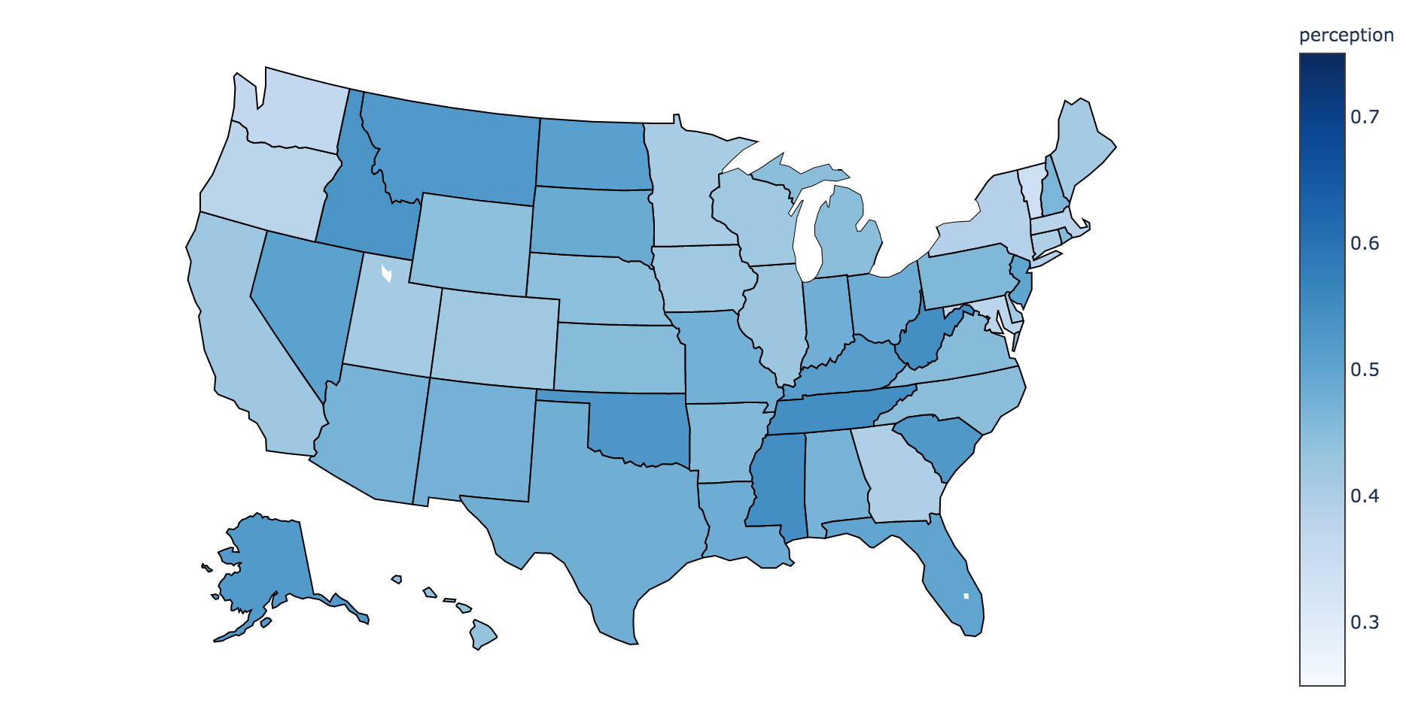
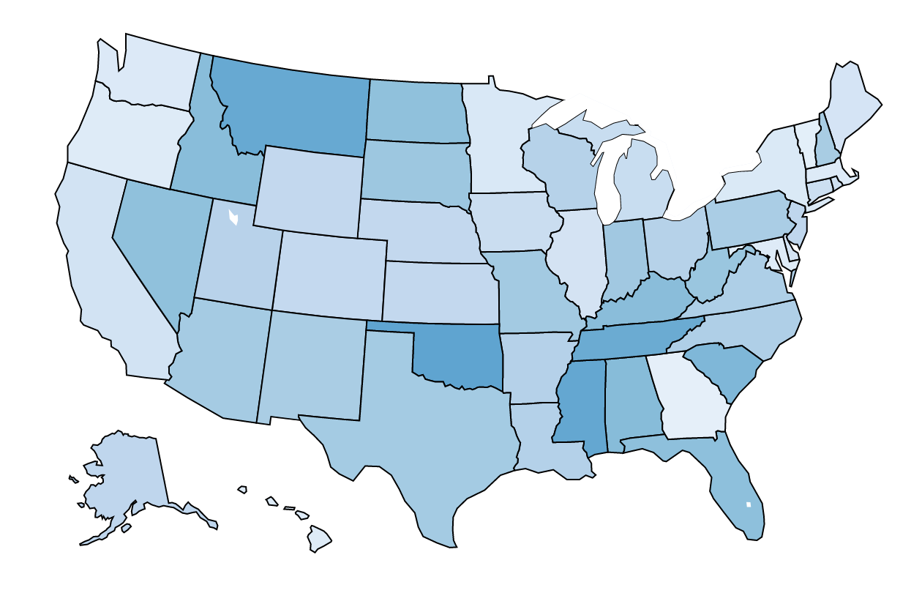
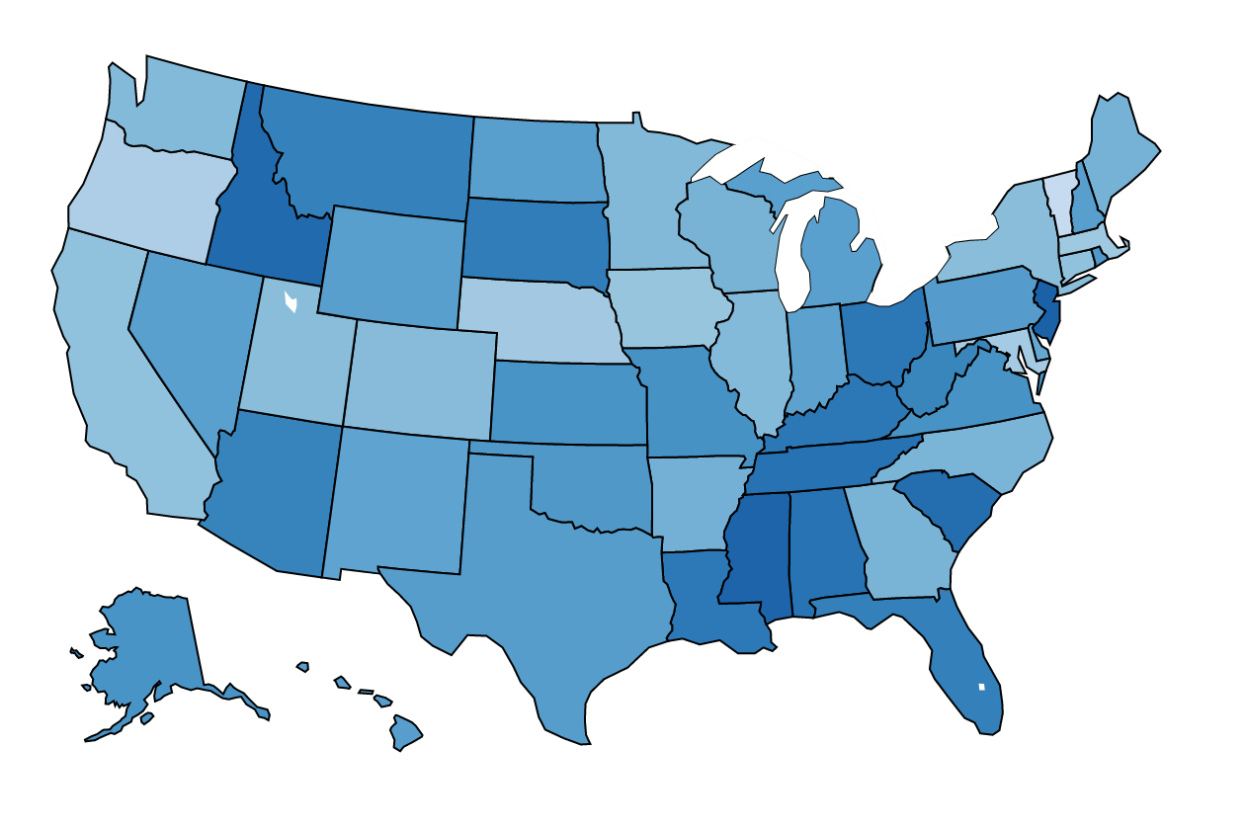
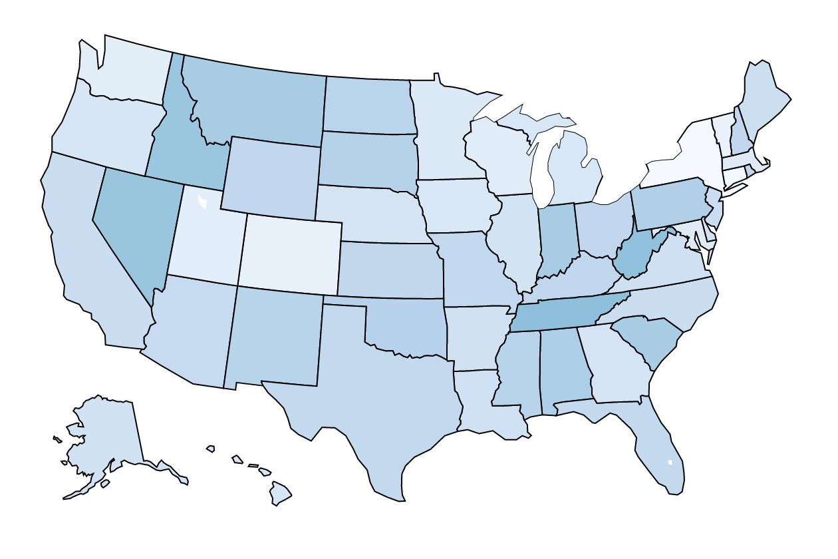
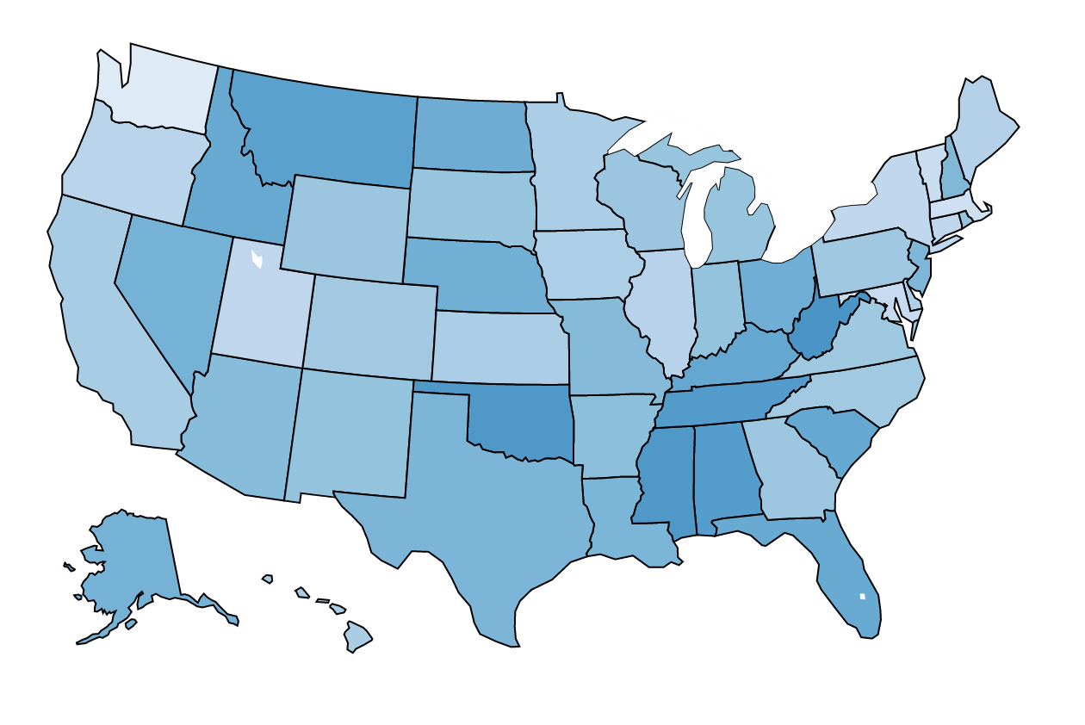
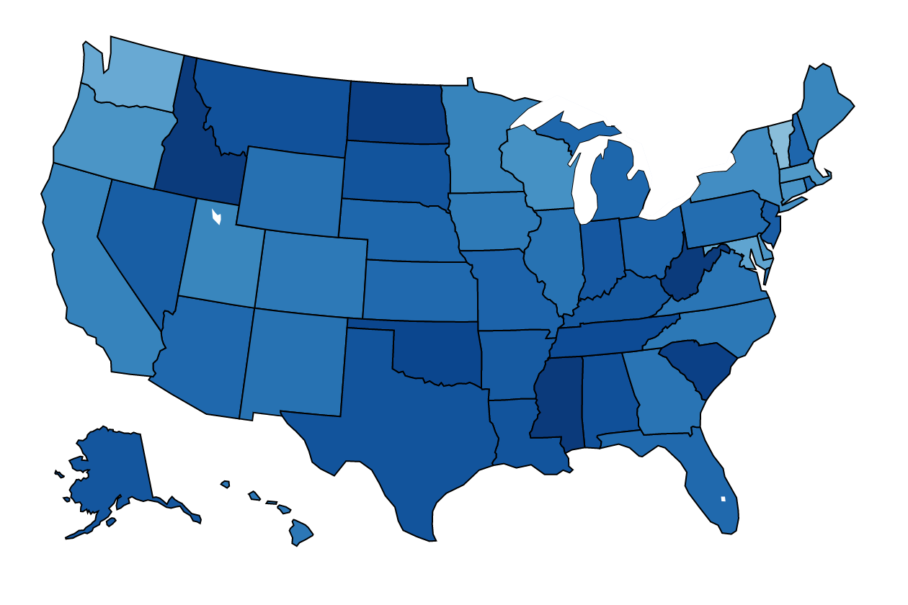
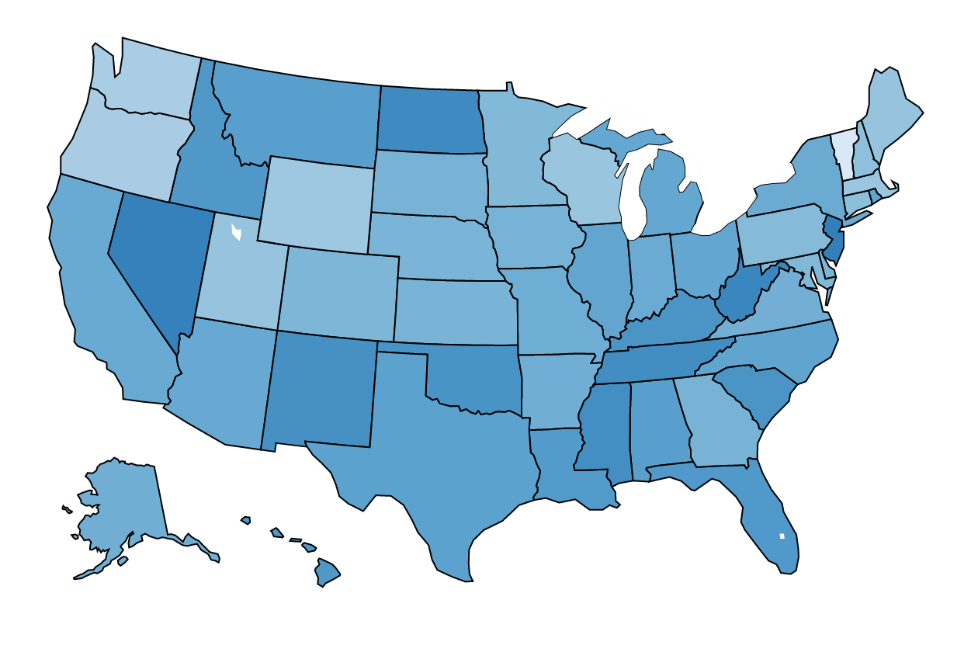
a.
Average perception for each state (04/17 ~ 05/30)
perception
b.
Average perception (04/17 ~ 04/23)
c.
Average perception (04/24 ~ 04/30)
d.
Average perception (05/01 ~ 05/07)
e.
Average perception (05/08 ~ 05/14)
f.
Average perception (05/15 ~ 05/21)
g.
Average perception (05/22 ~ 05/28)

Slide 3
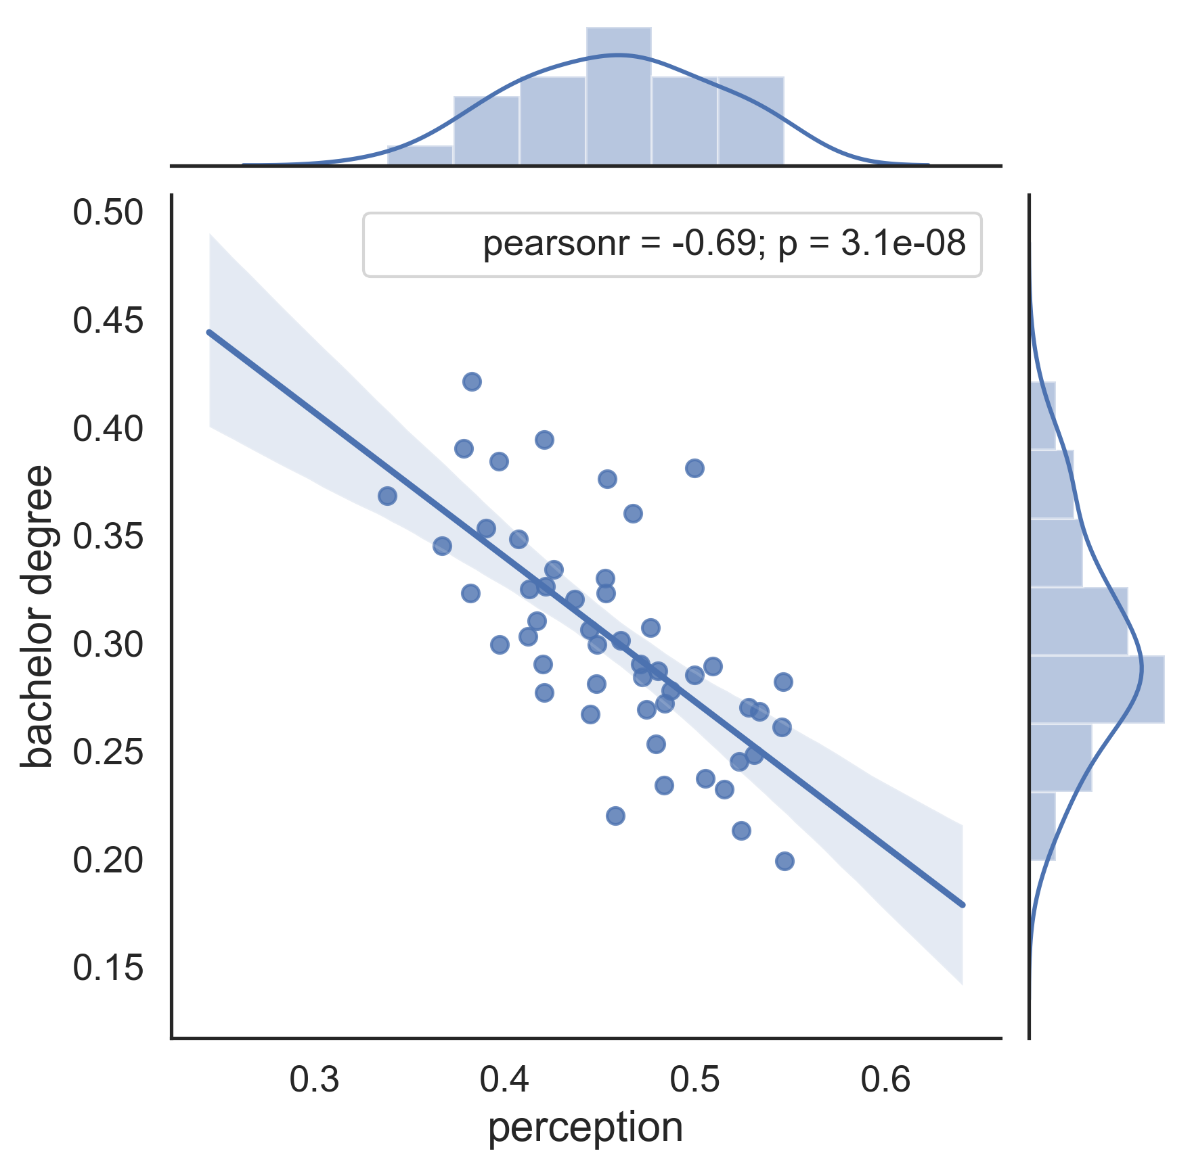
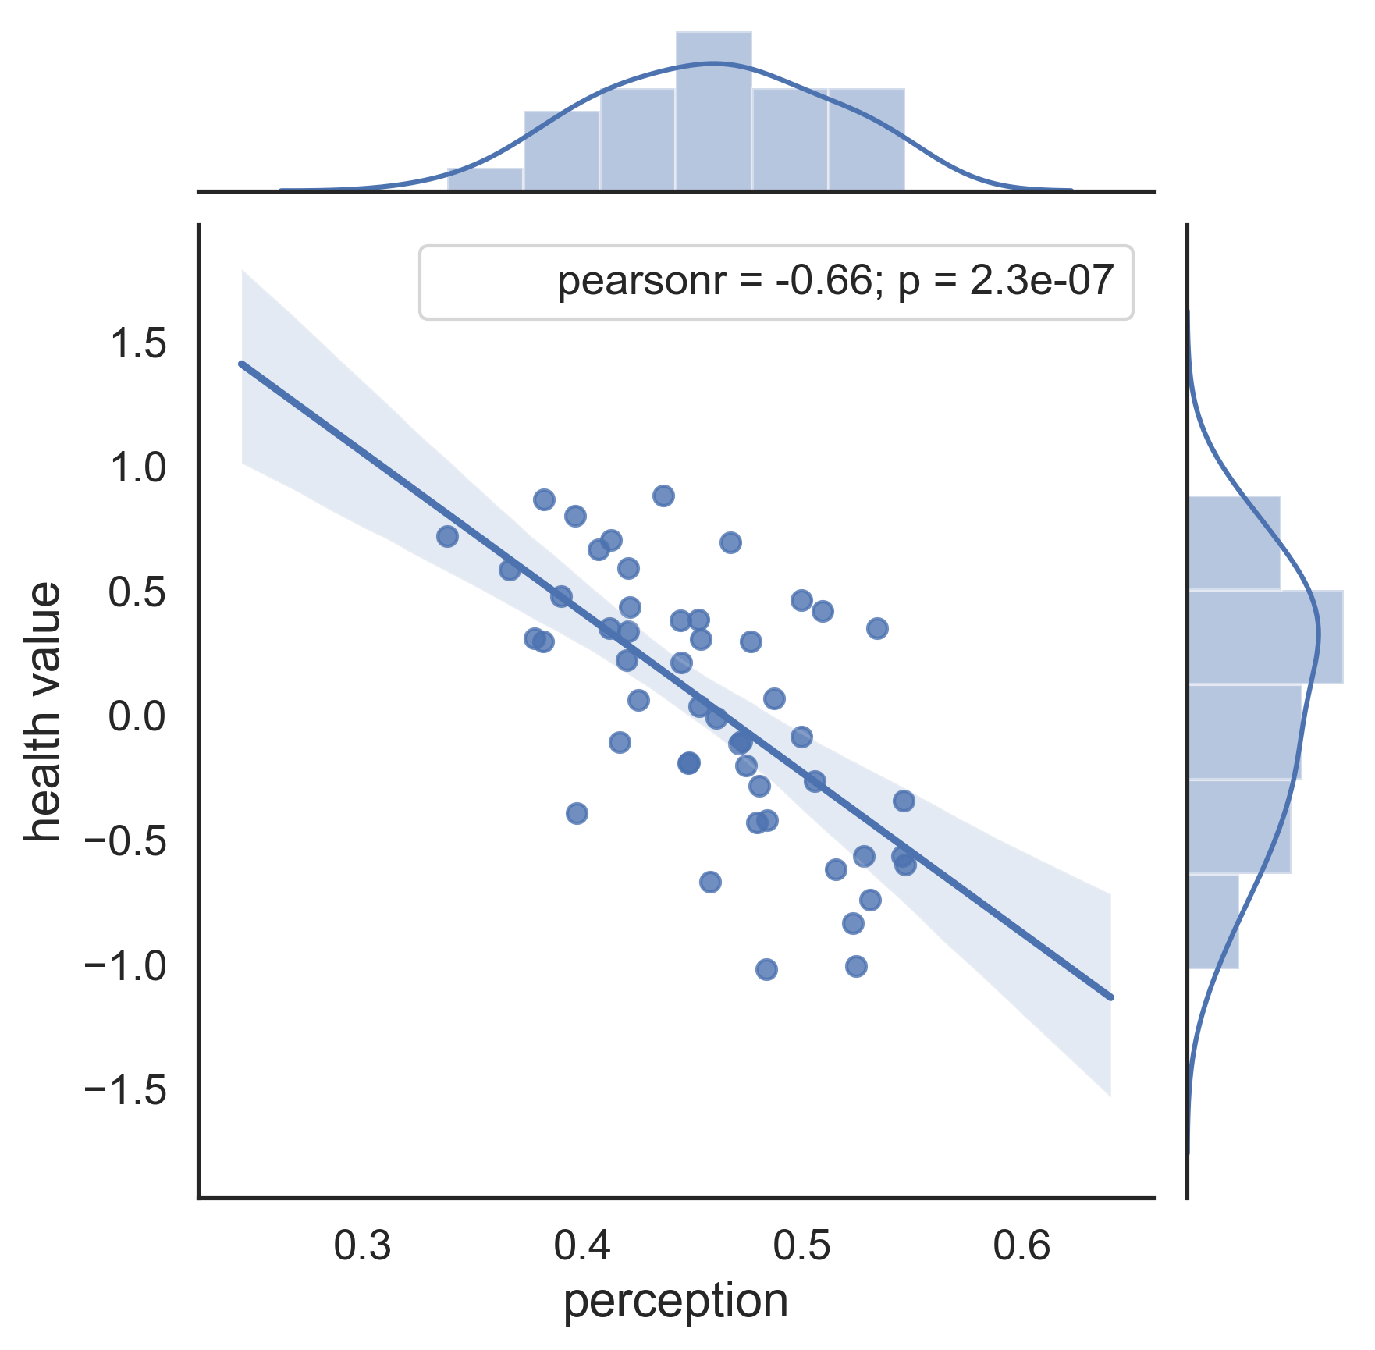
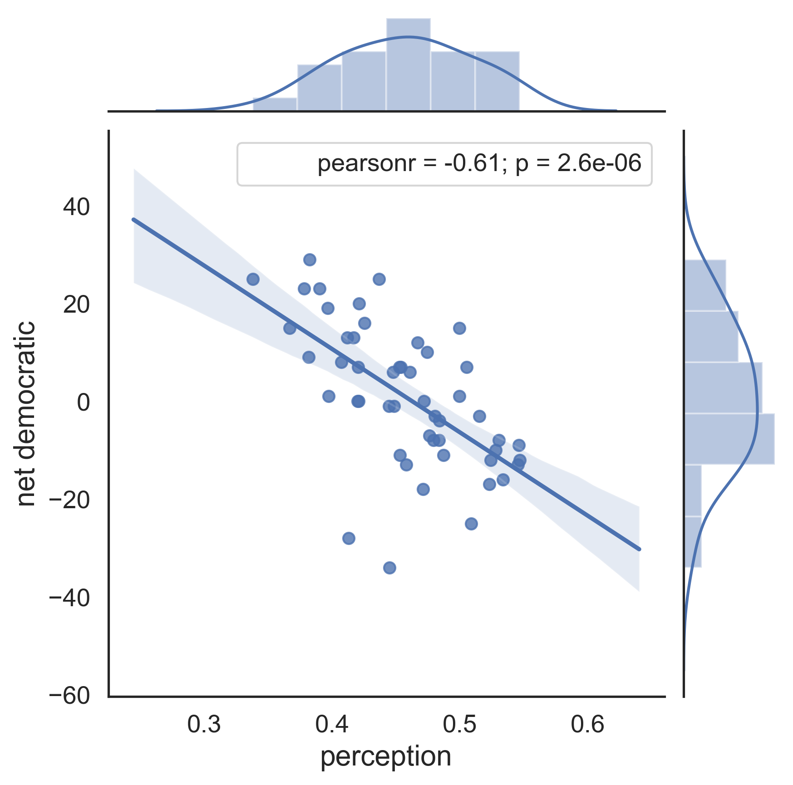
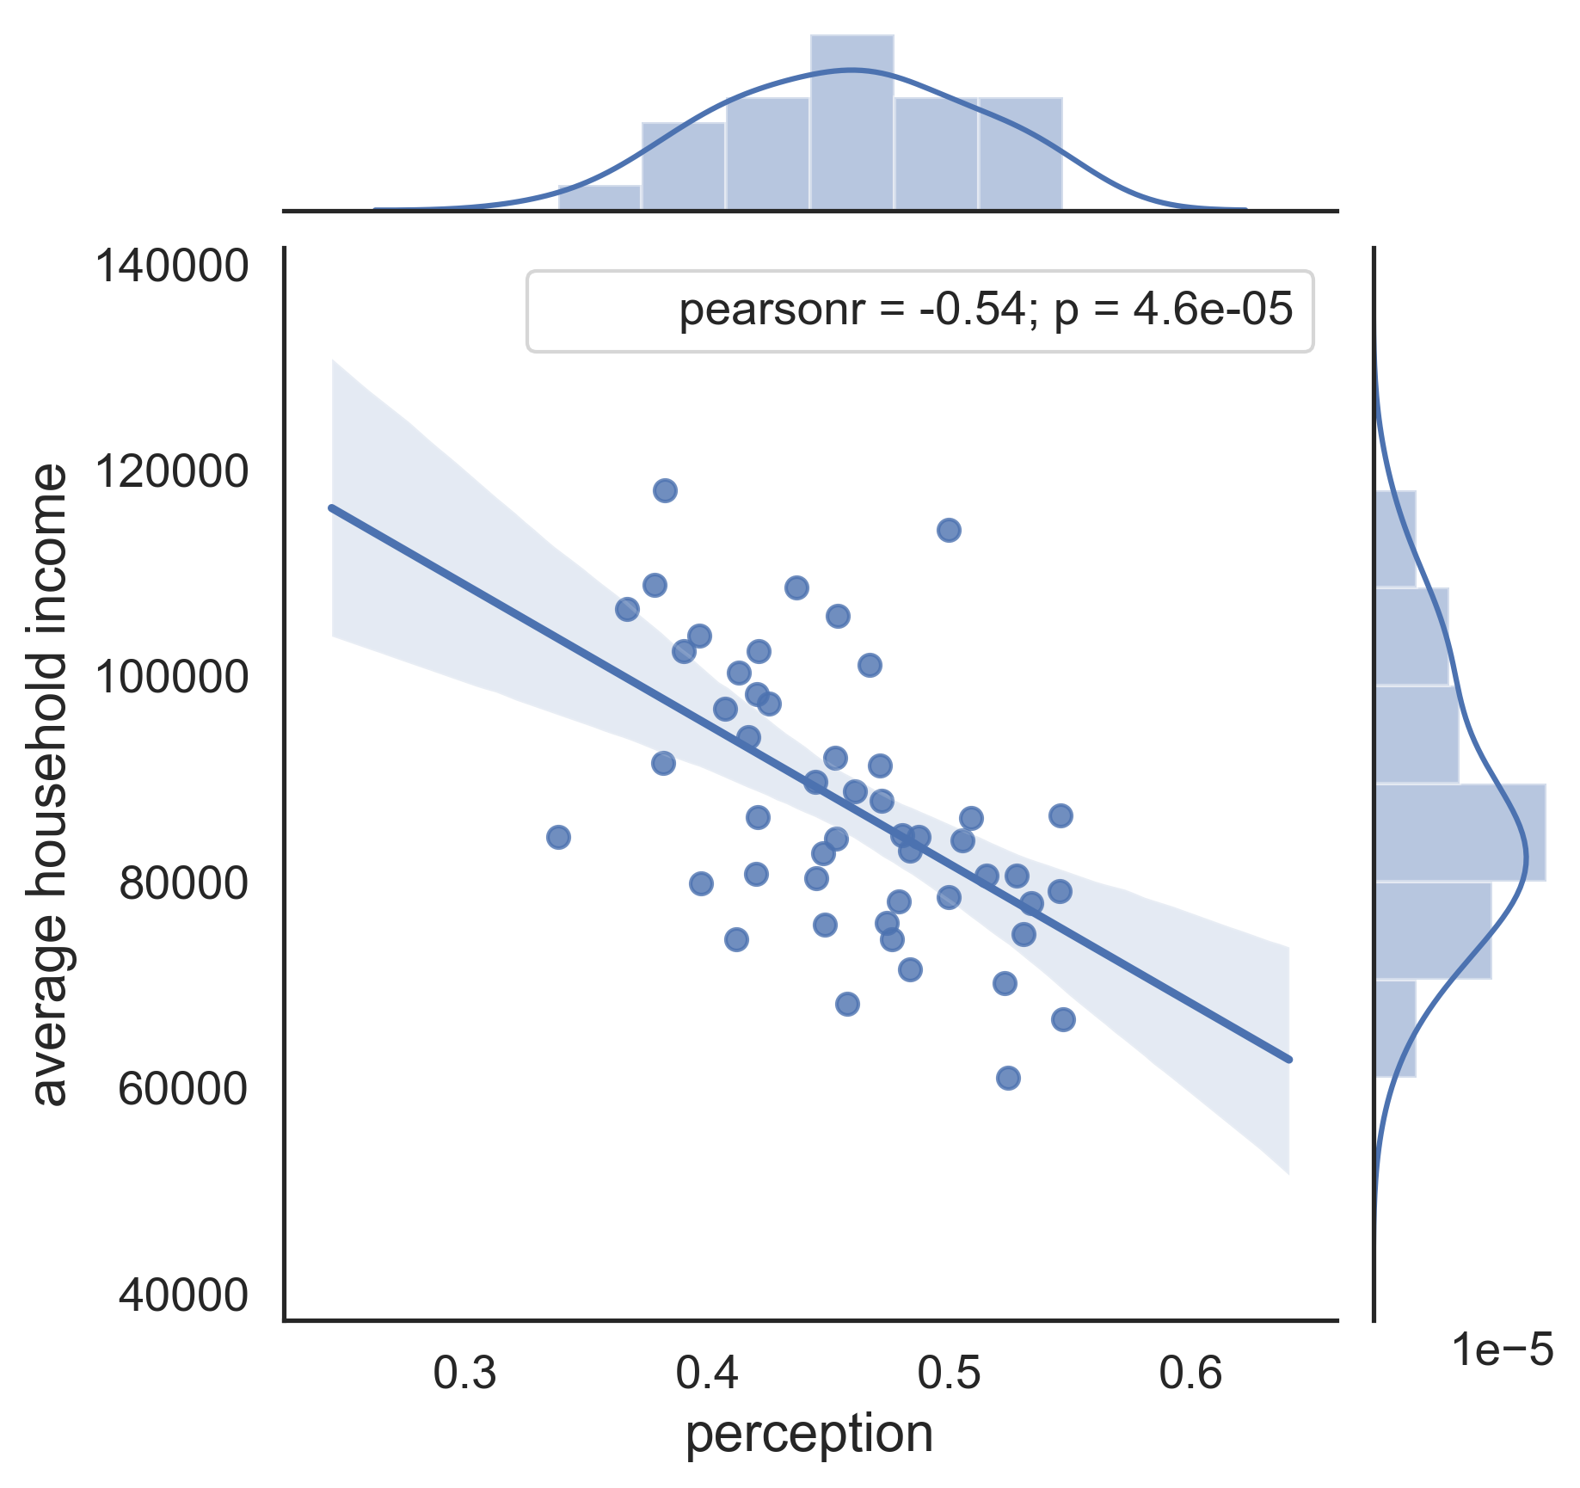
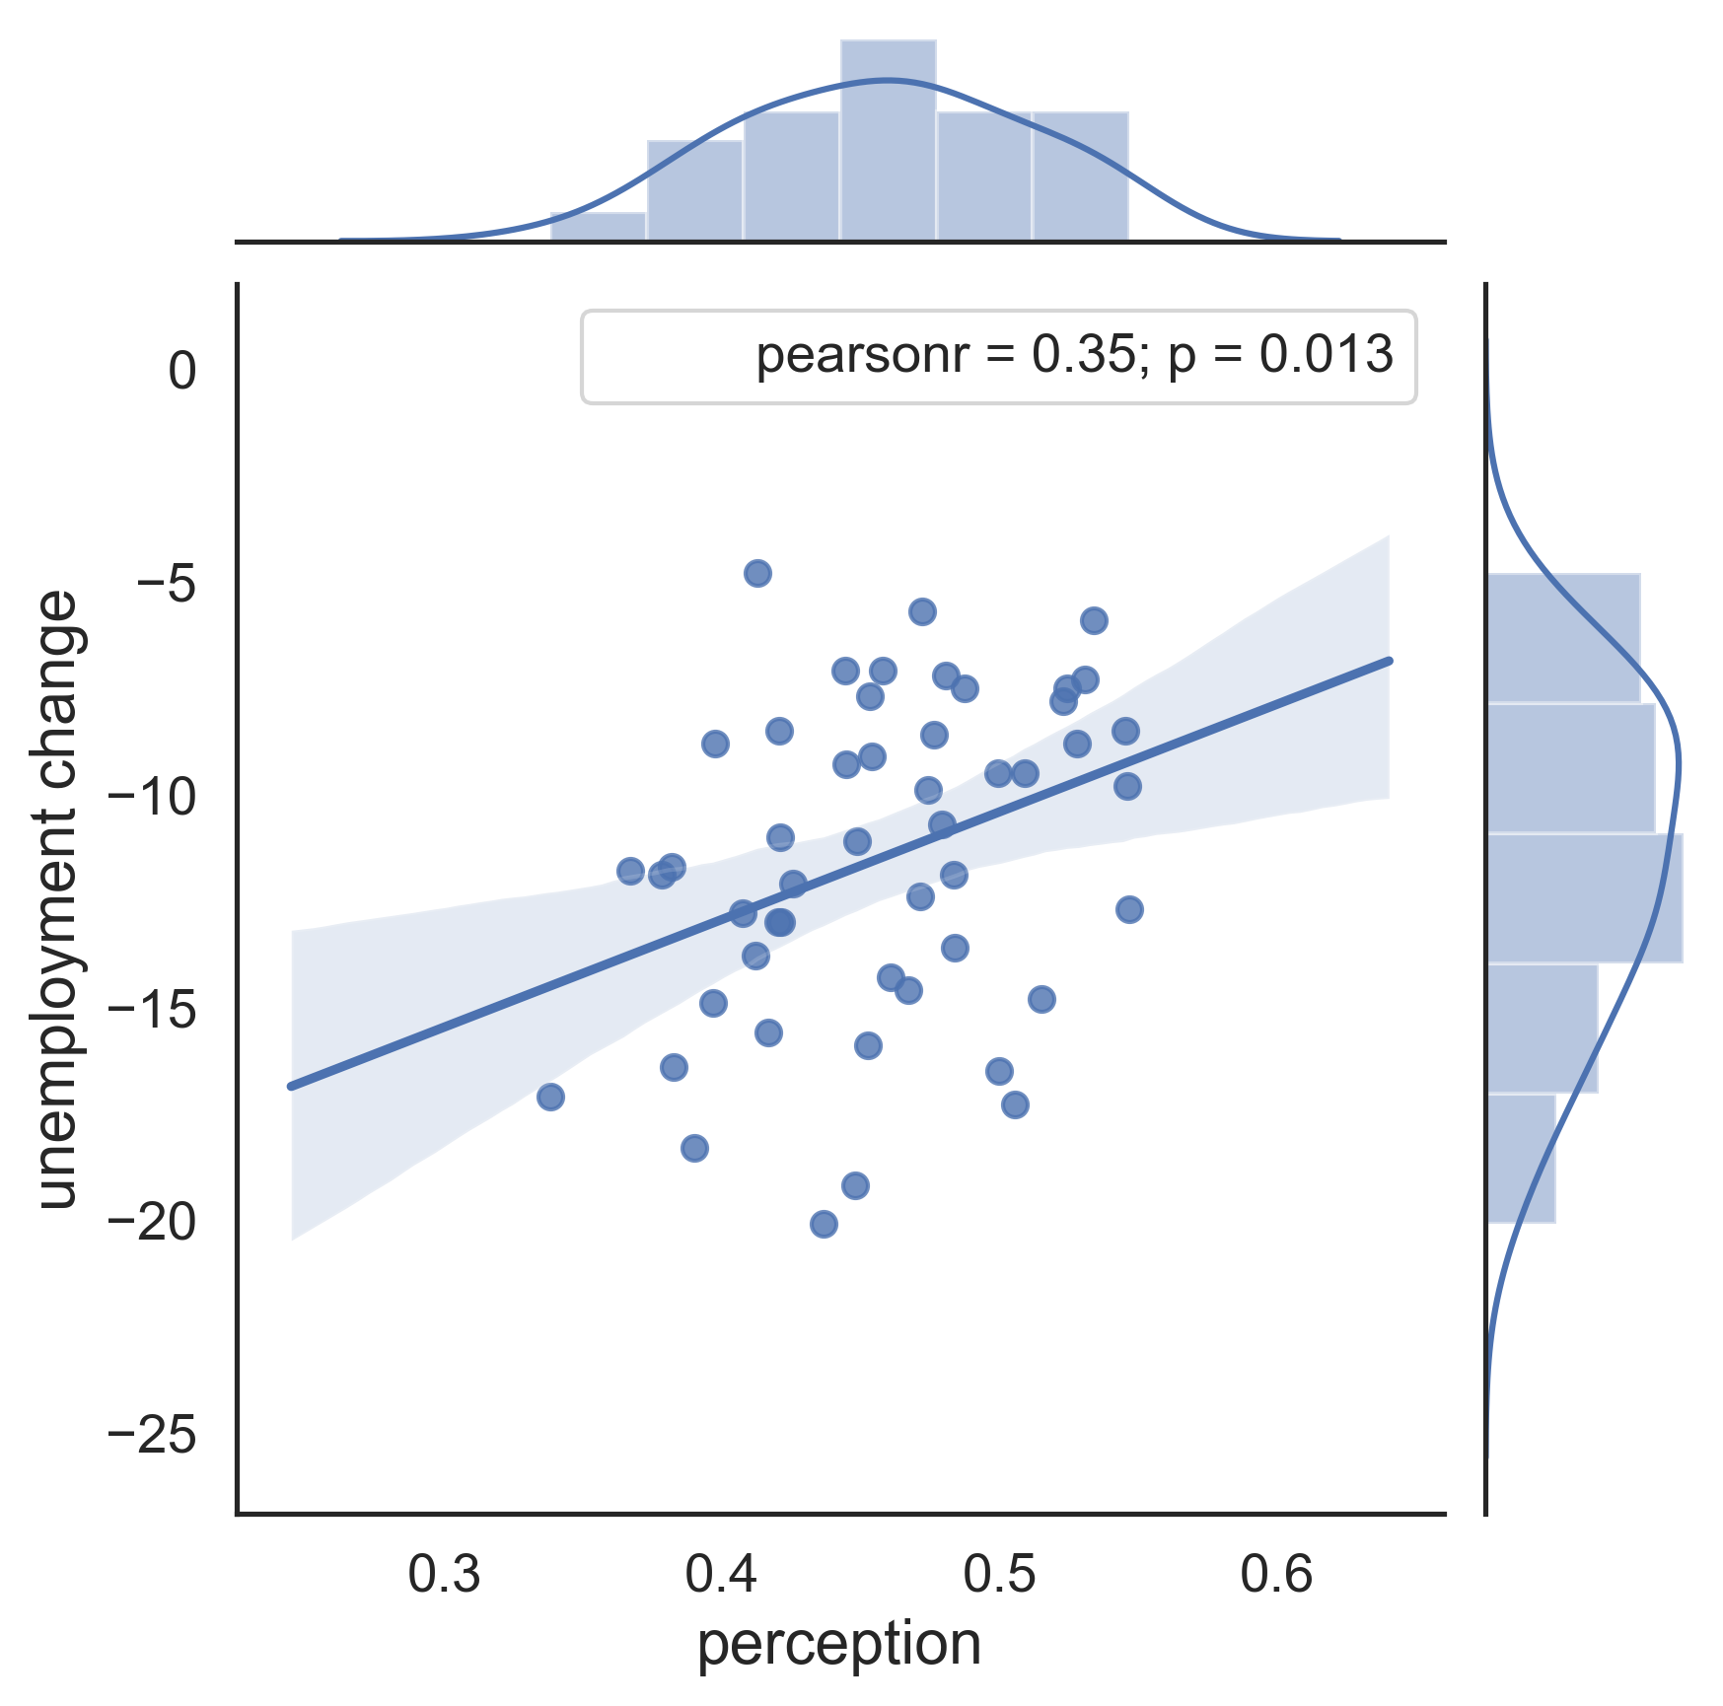
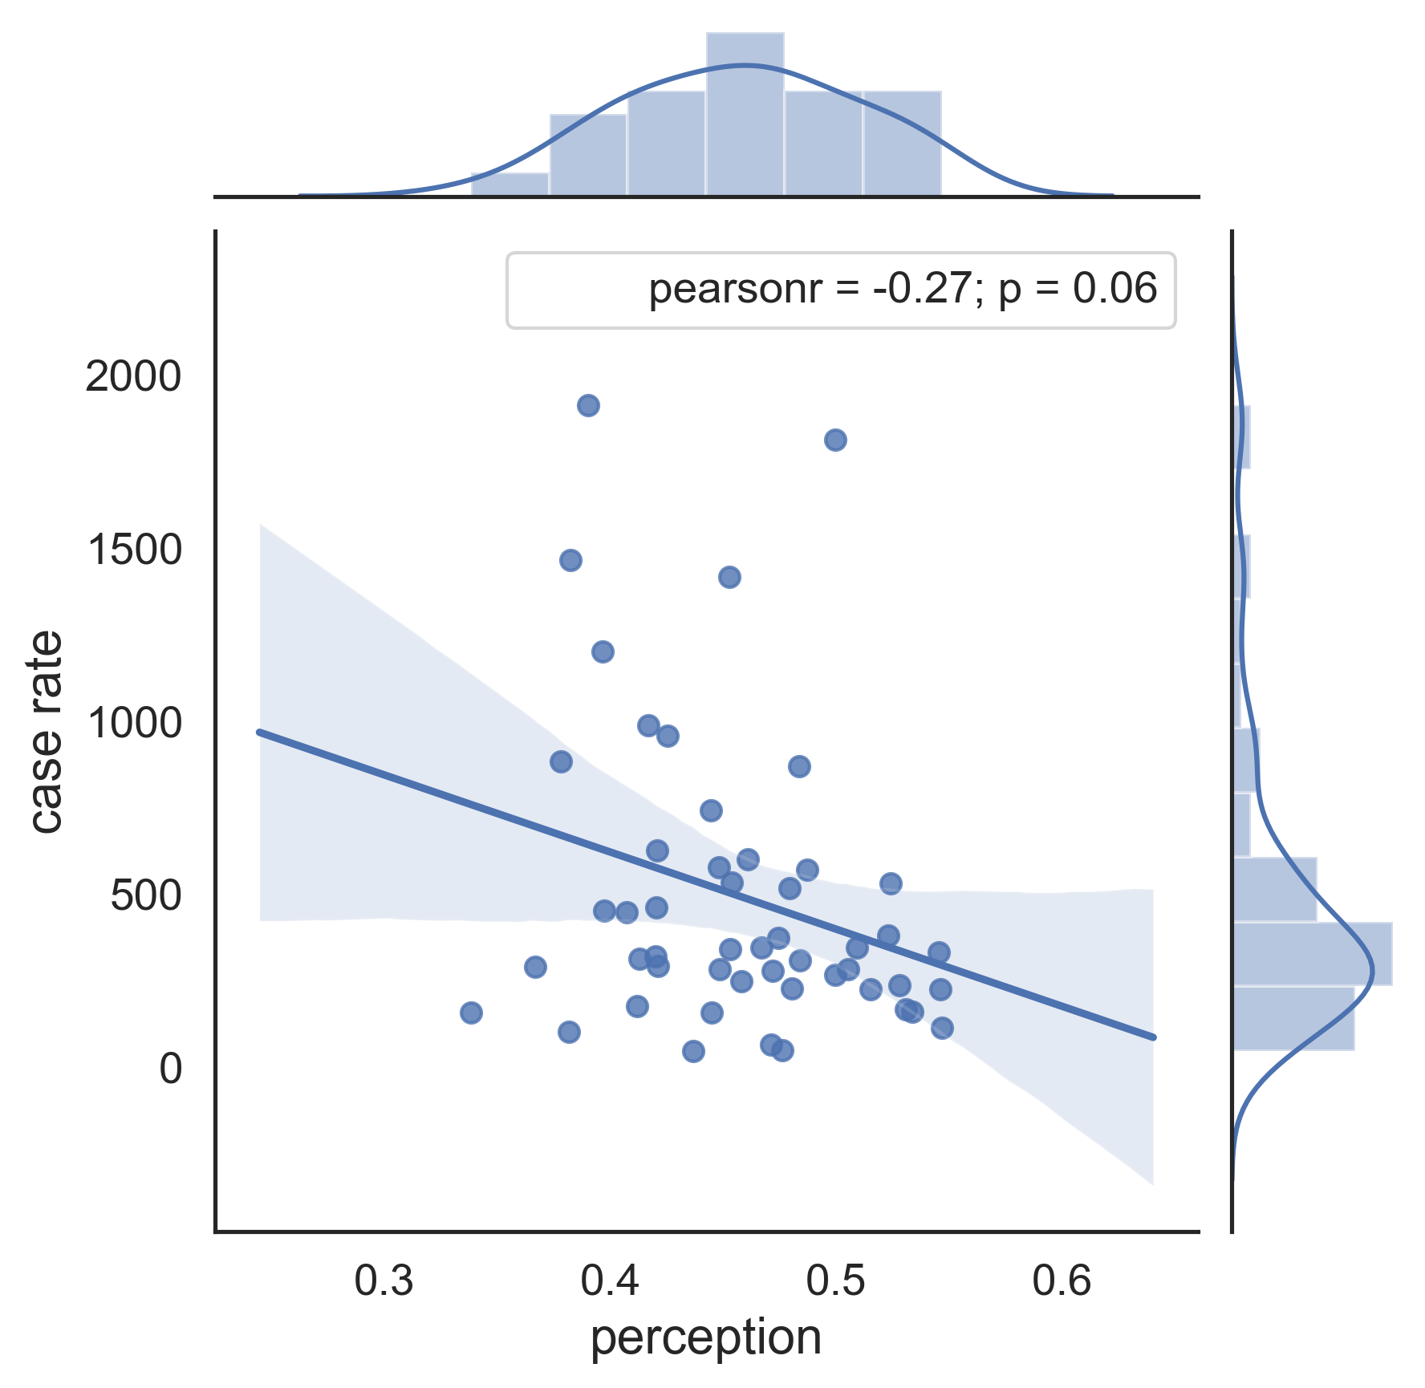
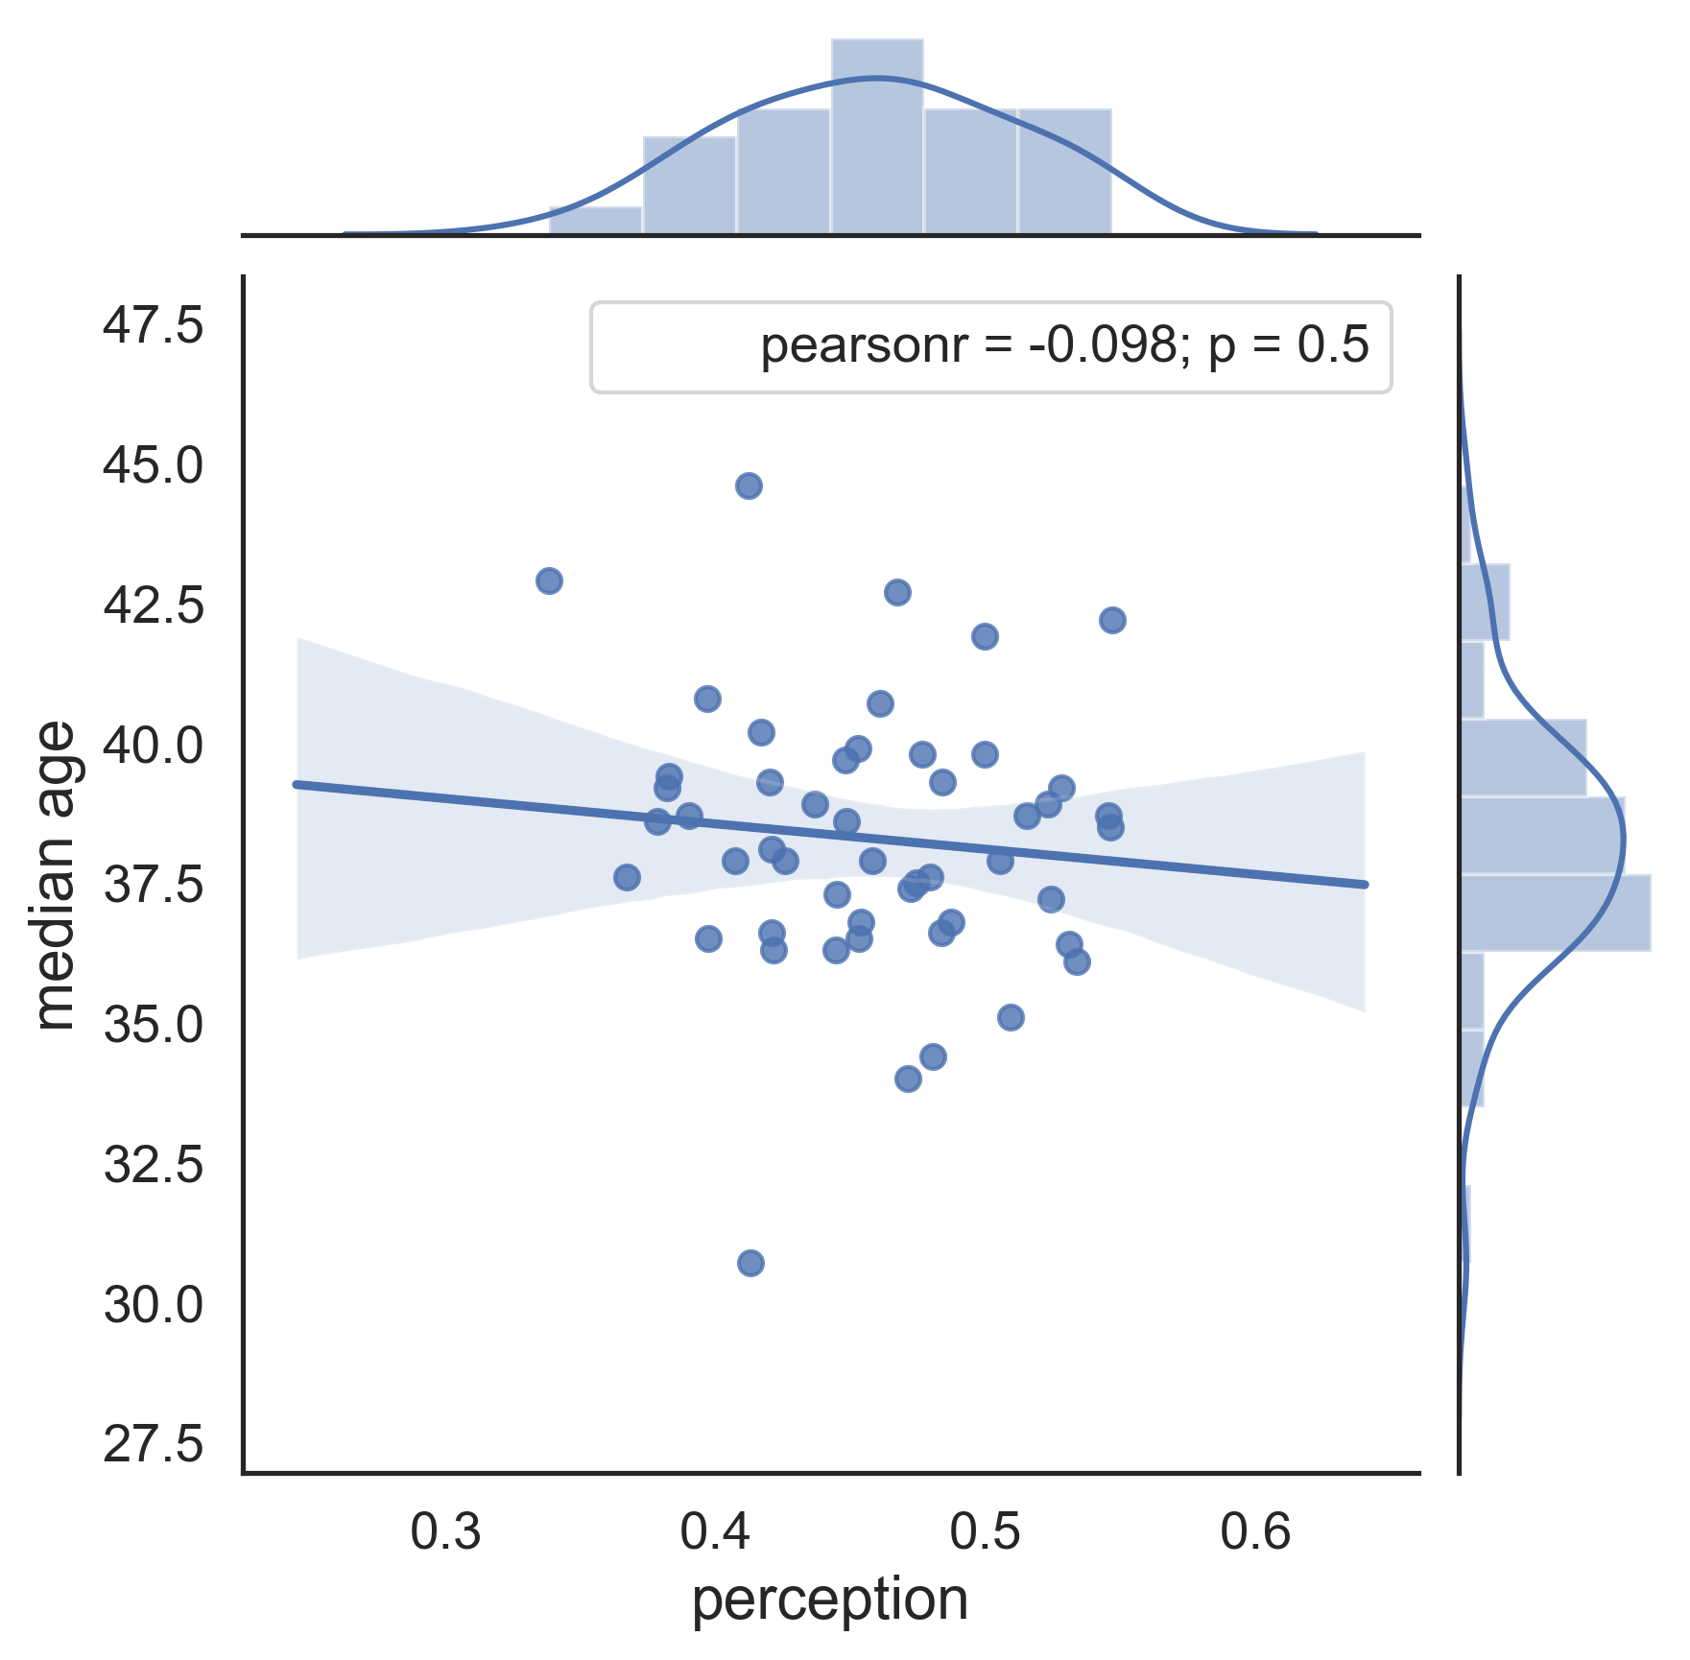
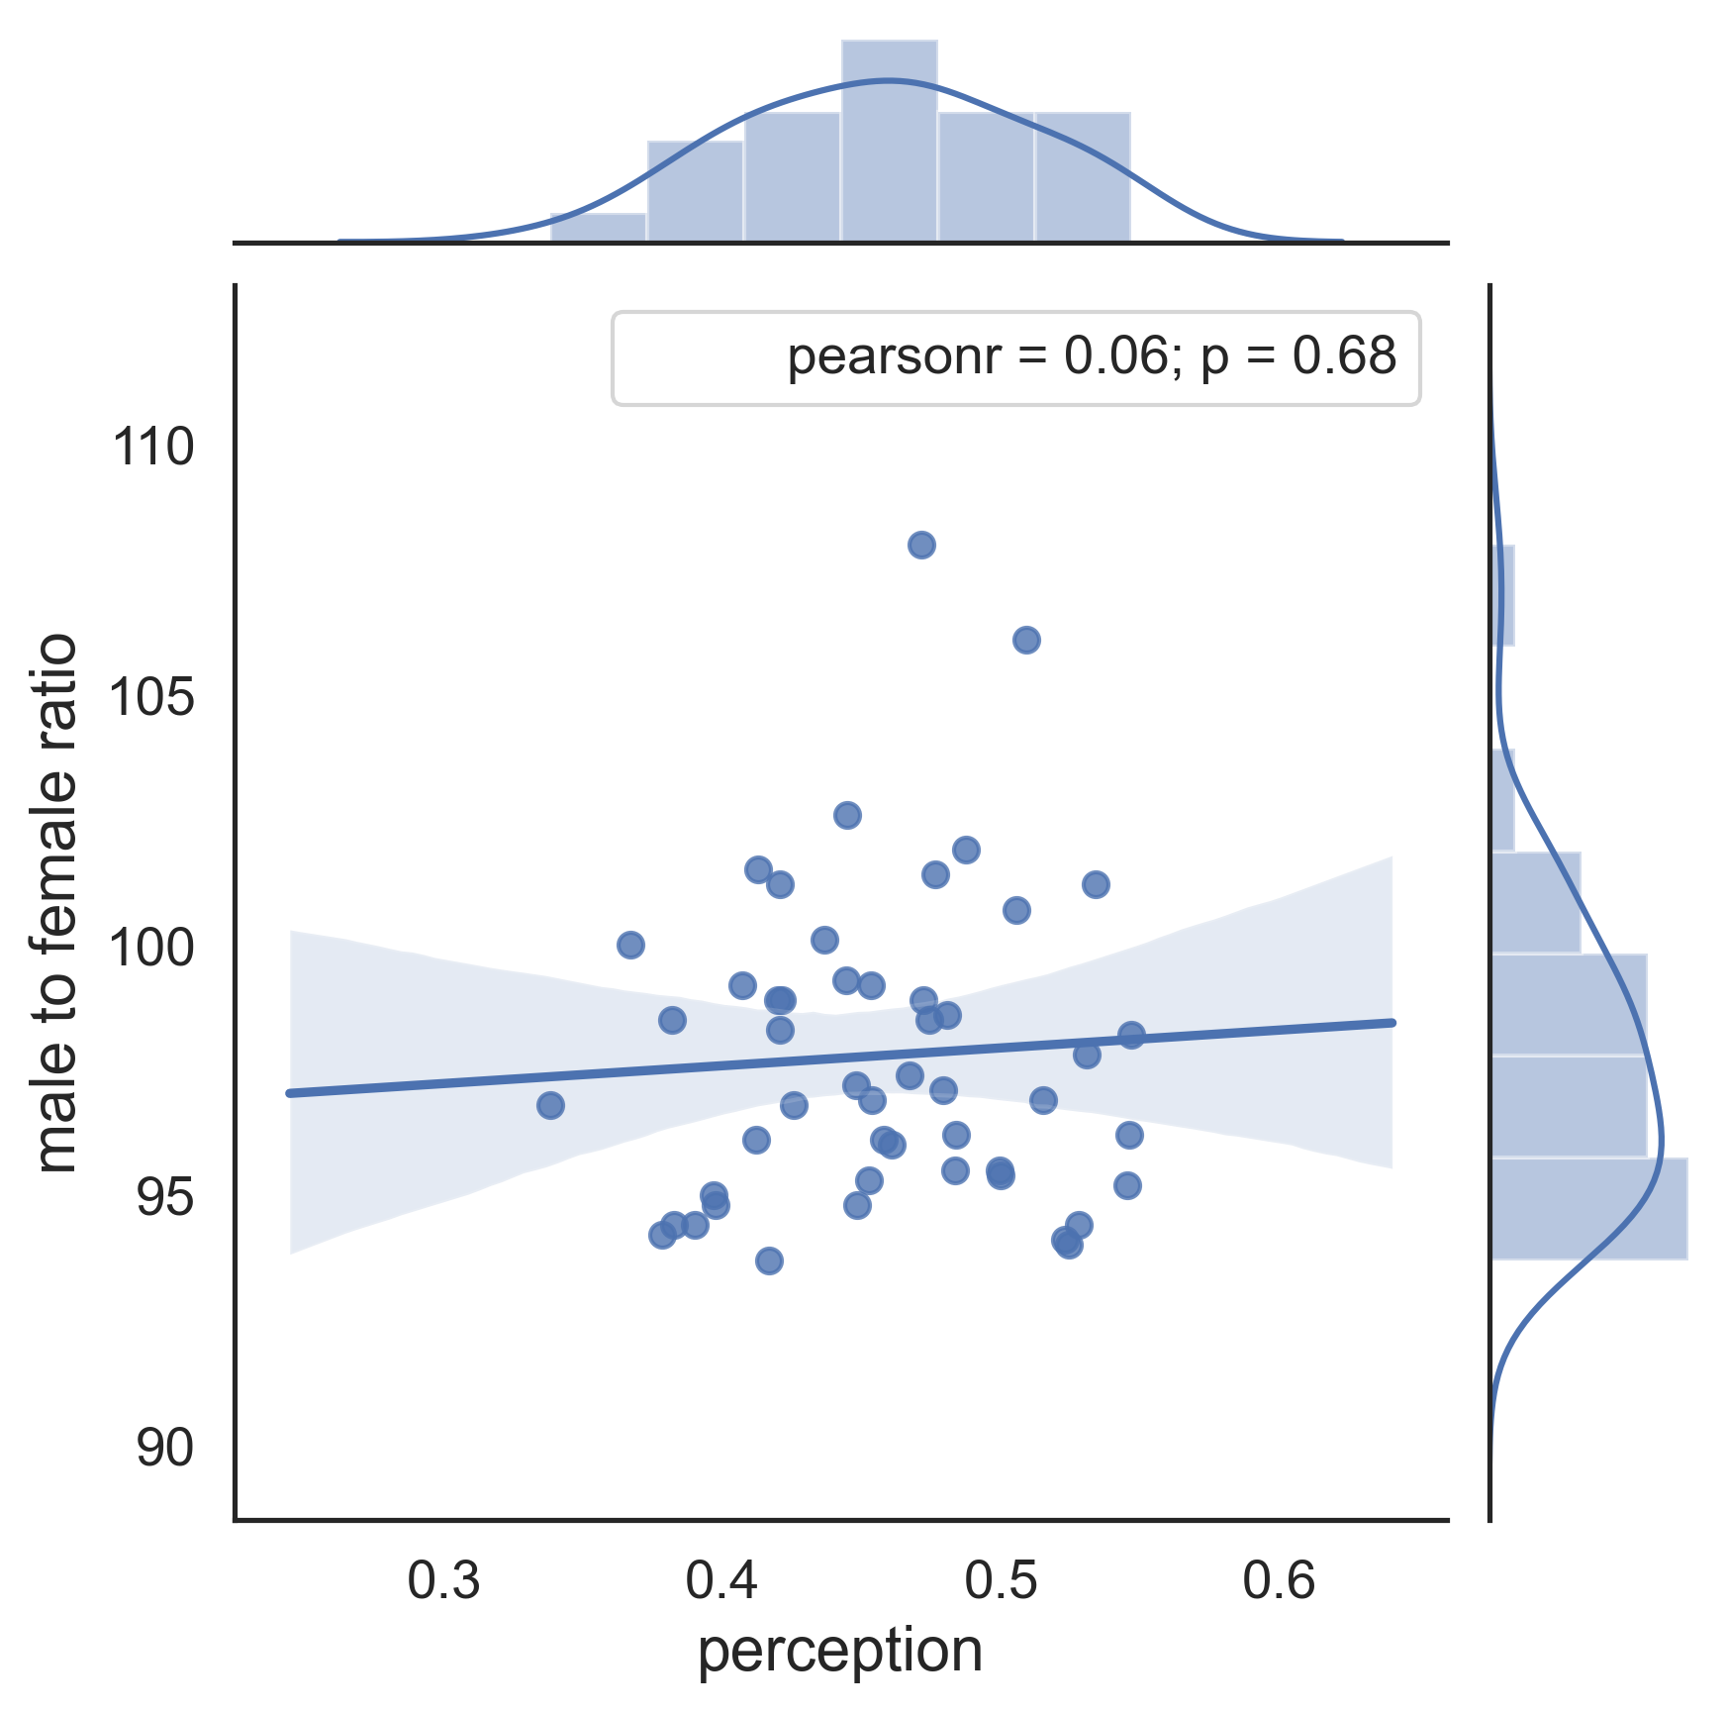
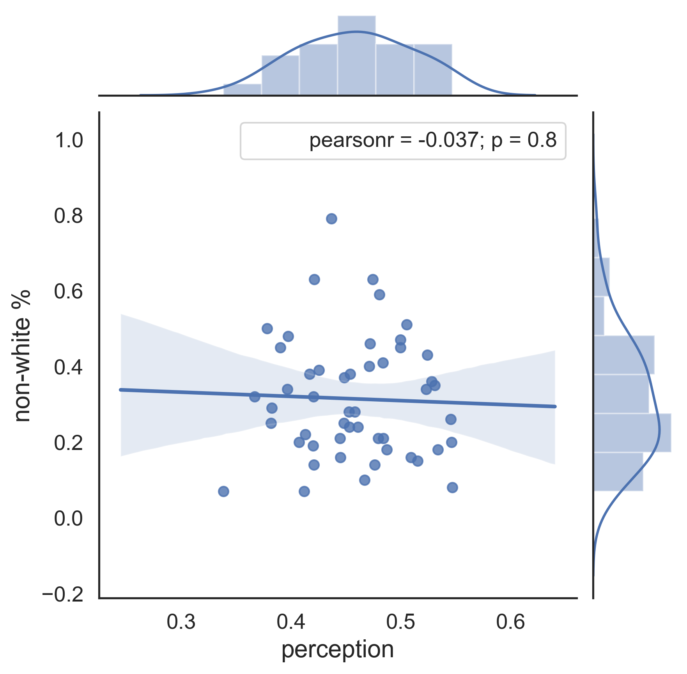
a.
b.
c.
d.
e.
f.
g.
h.
i.

Slide 4
5,000 manual labeled tweets
Unrelated patterns
A tweet
Same as manual label: class 1, class -1, or unrelated
Class 1
1,630 tweets
Same as manual label?
Yes
Text Cleaning
Class -1
Label as unrelated?
No
1,950 tweets
No
Text Augmentation
Contain unrelated pattern
Yes
Yes
Remove from the dataset
Training dataset
TF-IDF Vectorization
No
Class 1: 9,780
Multinomial Bayes Classification
Text Cleaning
Class -1: 9,750
Remove RT @user and @user
Remove digits, punctuations, emojis
2,333 manual labeled tweets
Remove stop-words
Trained Model
Remove URLs
Lemmatize words
Tokenize words
Testing dataset
apply trained model
Class 1: 744
Performance Measurement
Final Label
Class -1: 1,060
Train Text Classification Model
Label a Tweet in the Dataset

